Slide 1
Object detection model
Kartik Gupta

Slide 2
Aim
-To develop a model that can correctly detect plastic(s),idol(s),flower(s),debris.

Slide 3
Data preparation
Labels
Scraping using google_images_download module.
Idol(s) - ‘i’
Plastic(s) - ‘p’
Flower(s) - ‘f’
Debris - ‘d’

Slide 4
Sample images

Slide 5
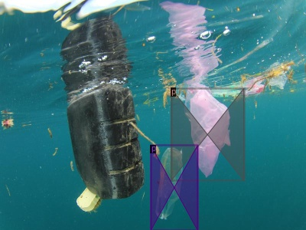
￼

Slide 6
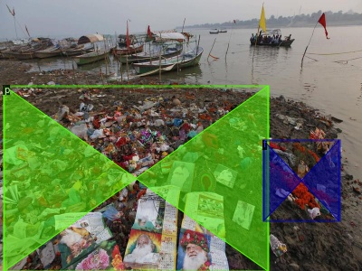

Slide 7
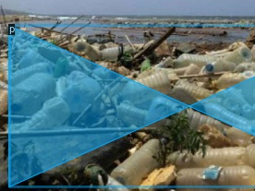

Slide 8
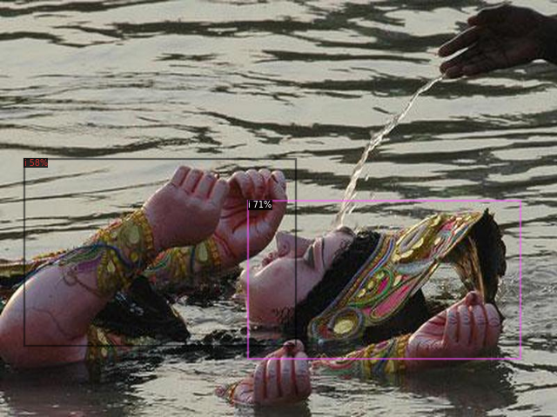

Slide 9
Training dataset size ~ 500 images with multiple images.

Slide 10
Algorithm and platform
Detectron v2 on google colab for high efficiency and accuracy.

Slide 11
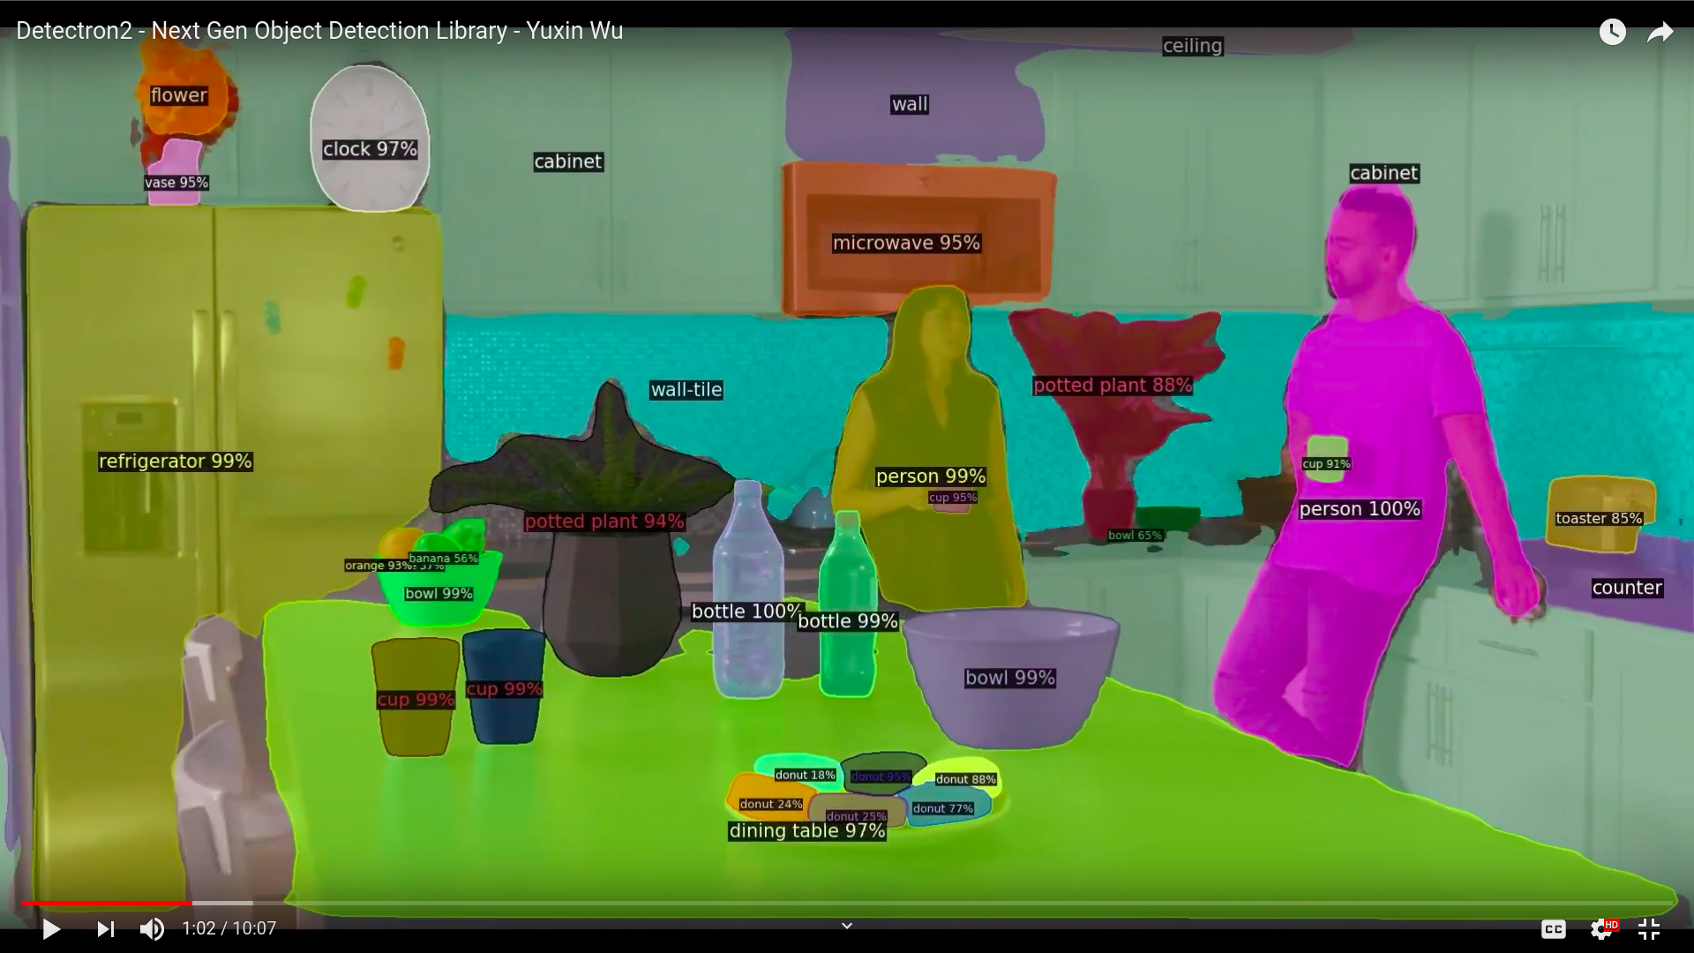

Slide 12
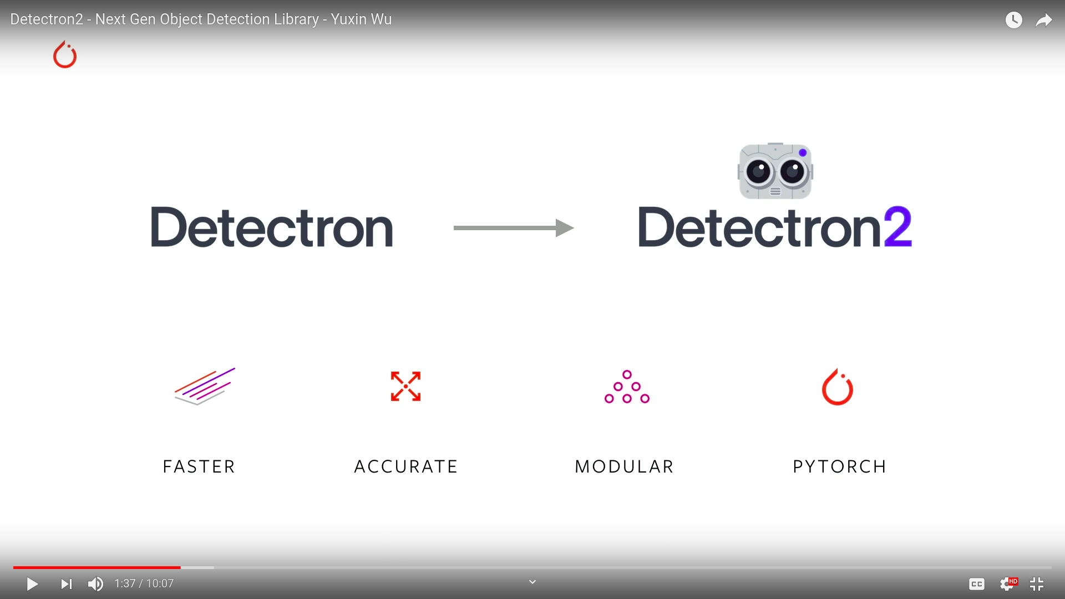
Results

Slide 13
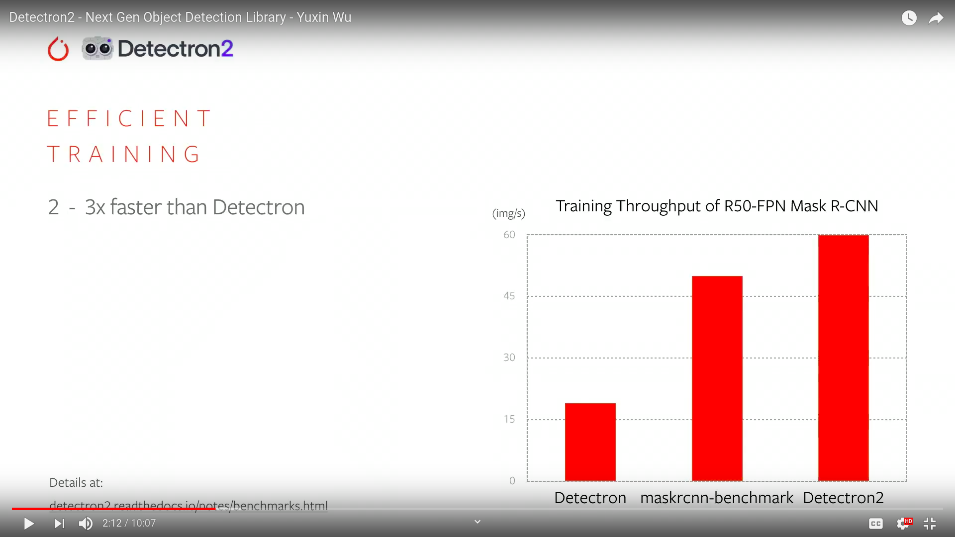

Slide 14
Modification to default settings
Learning rate is decreased to learn more complex features.
No. of iteration increased to overfit on training data.

Slide 15
Results:
On Training data:

Slide 16
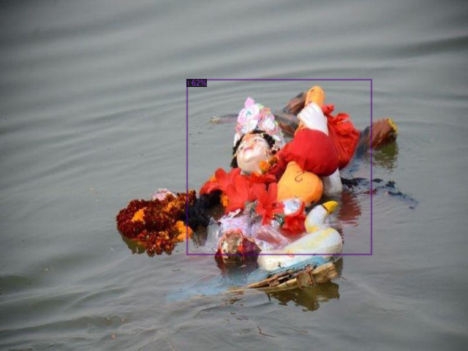

Slide 17
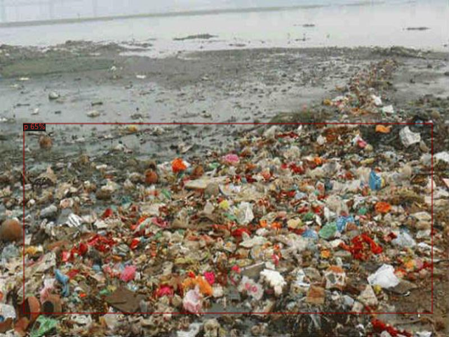

Slide 18
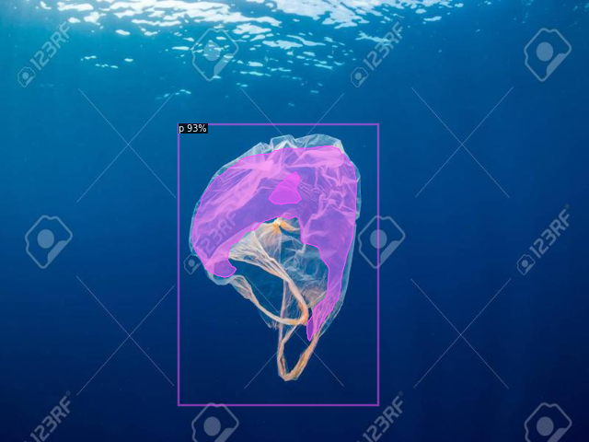

Slide 19
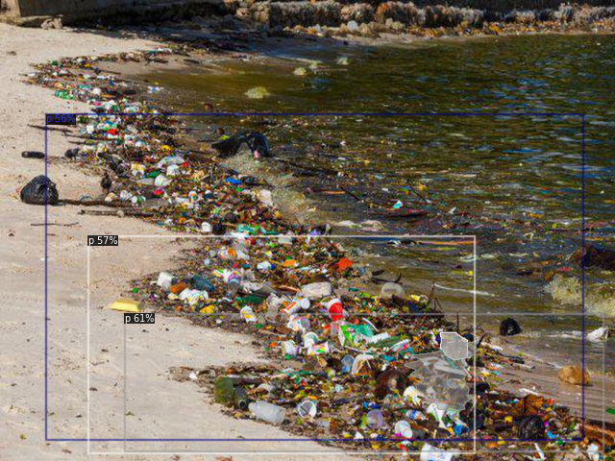

Slide 20
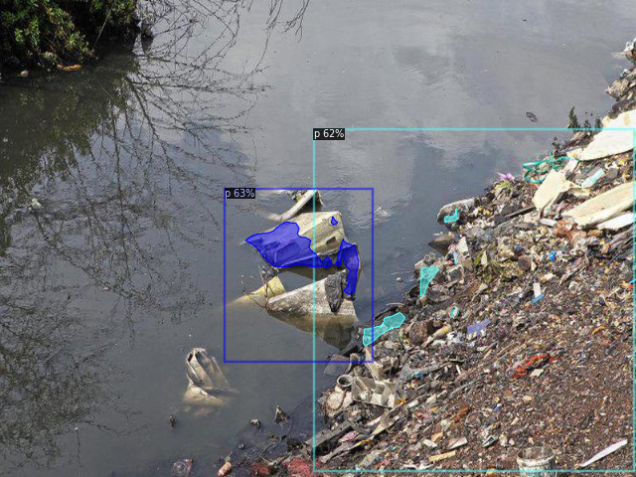

Slide 21
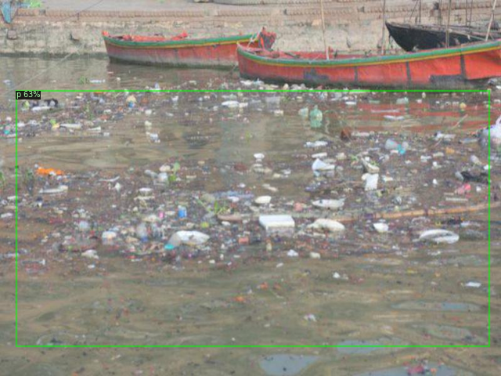

Slide 22
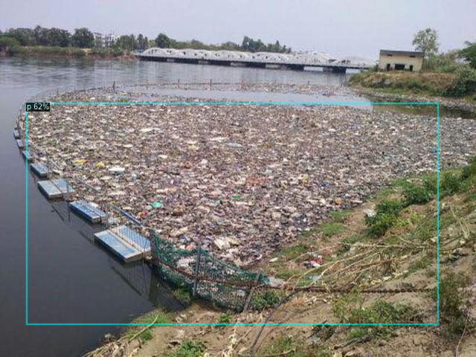

Slide 23
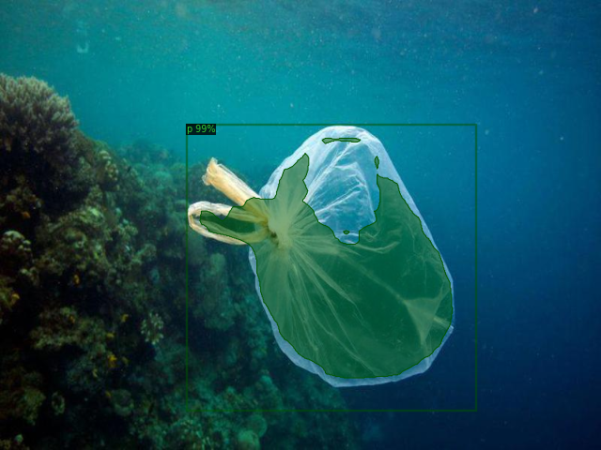

Slide 24
Results on test data

Slide 25
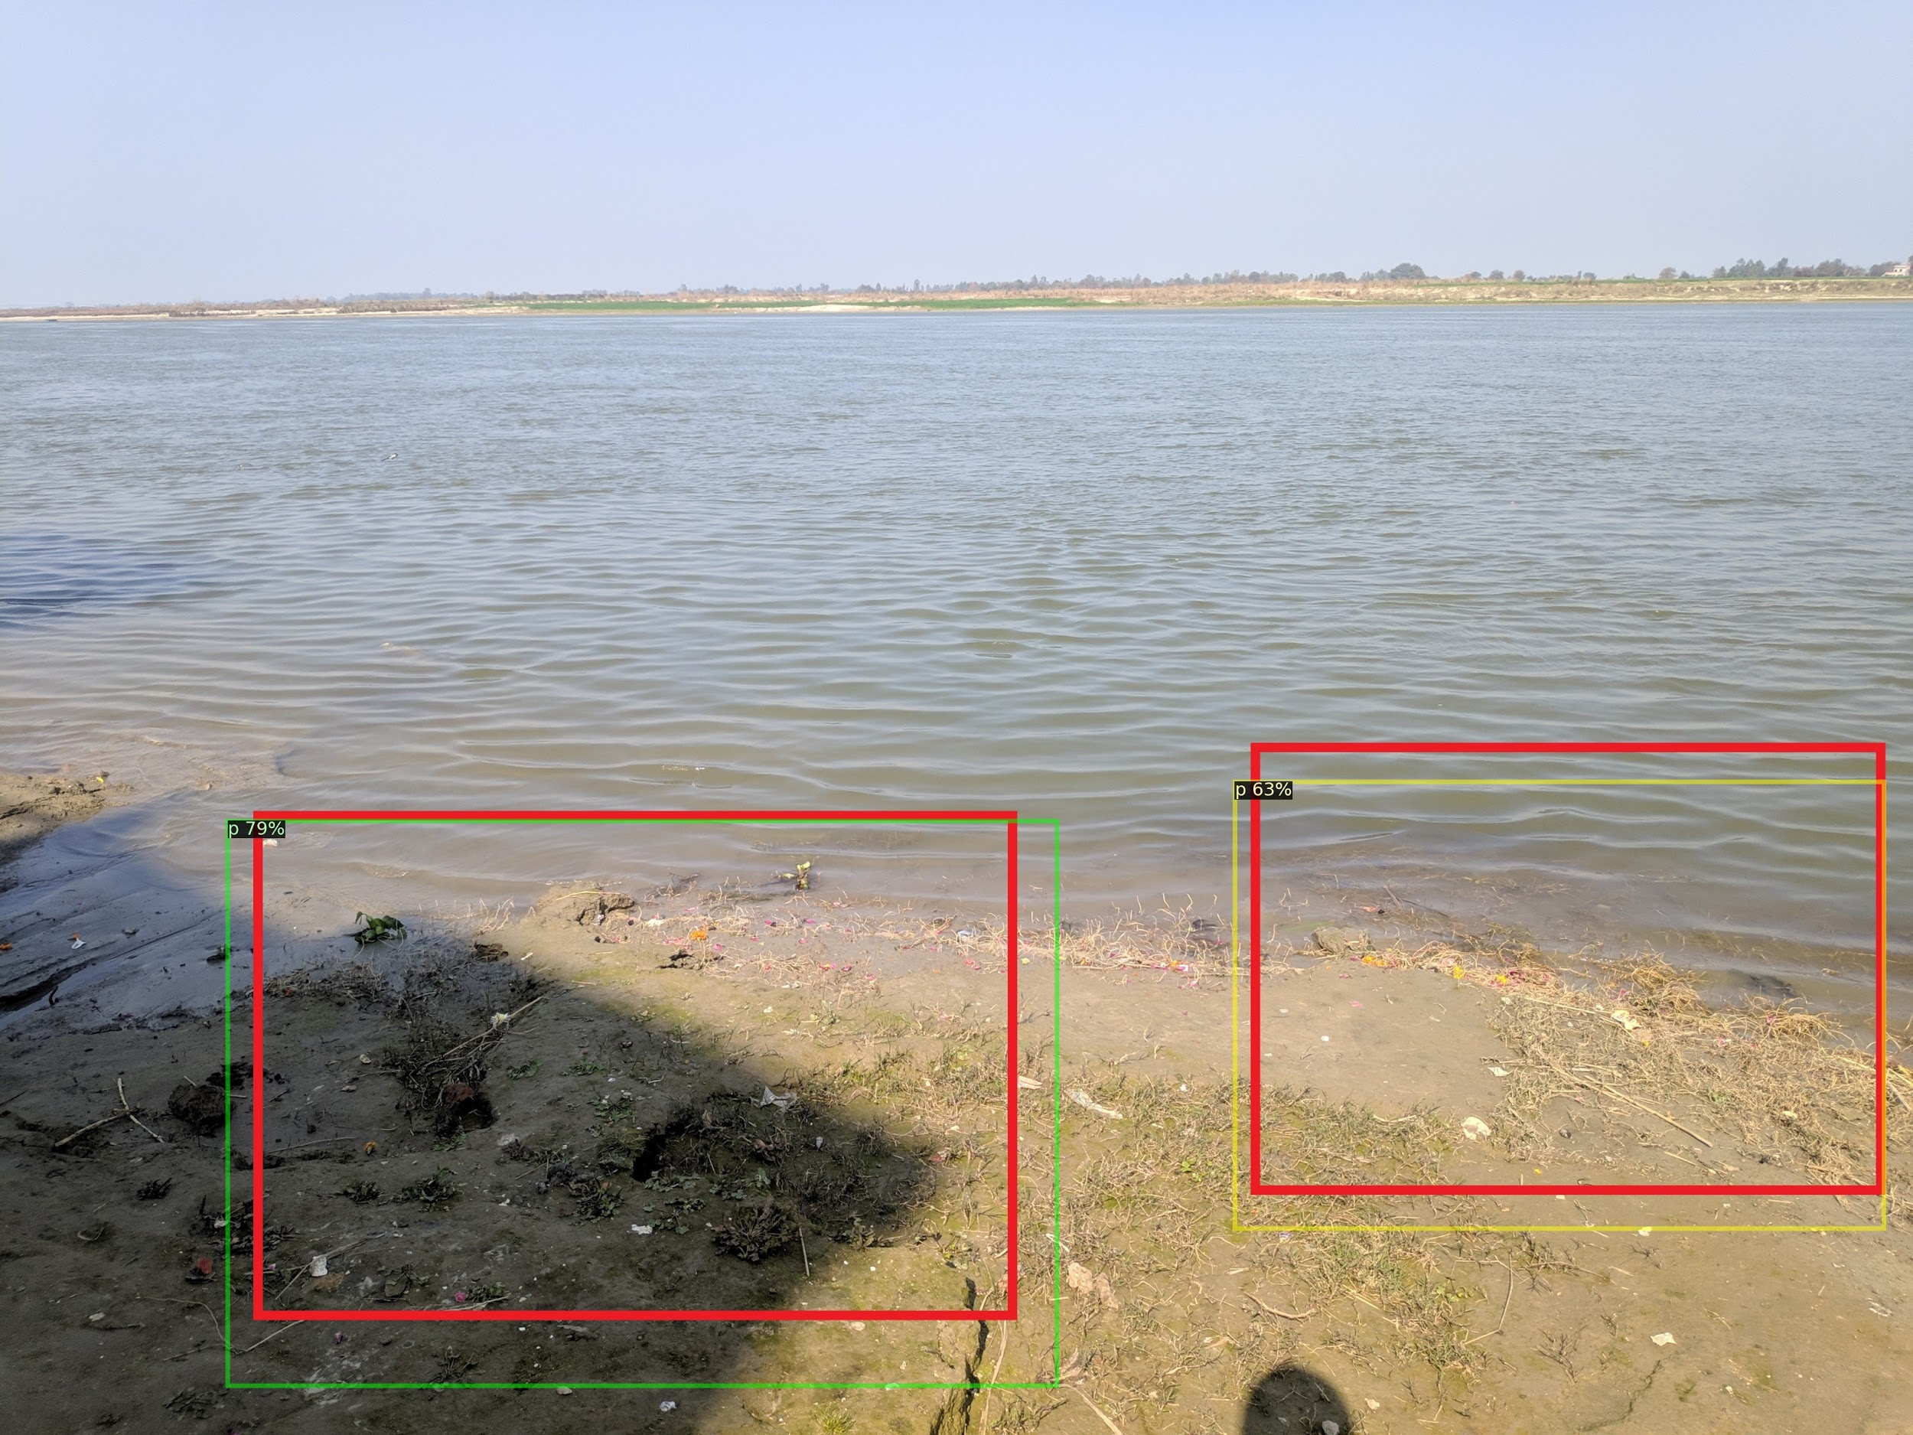

Slide 26
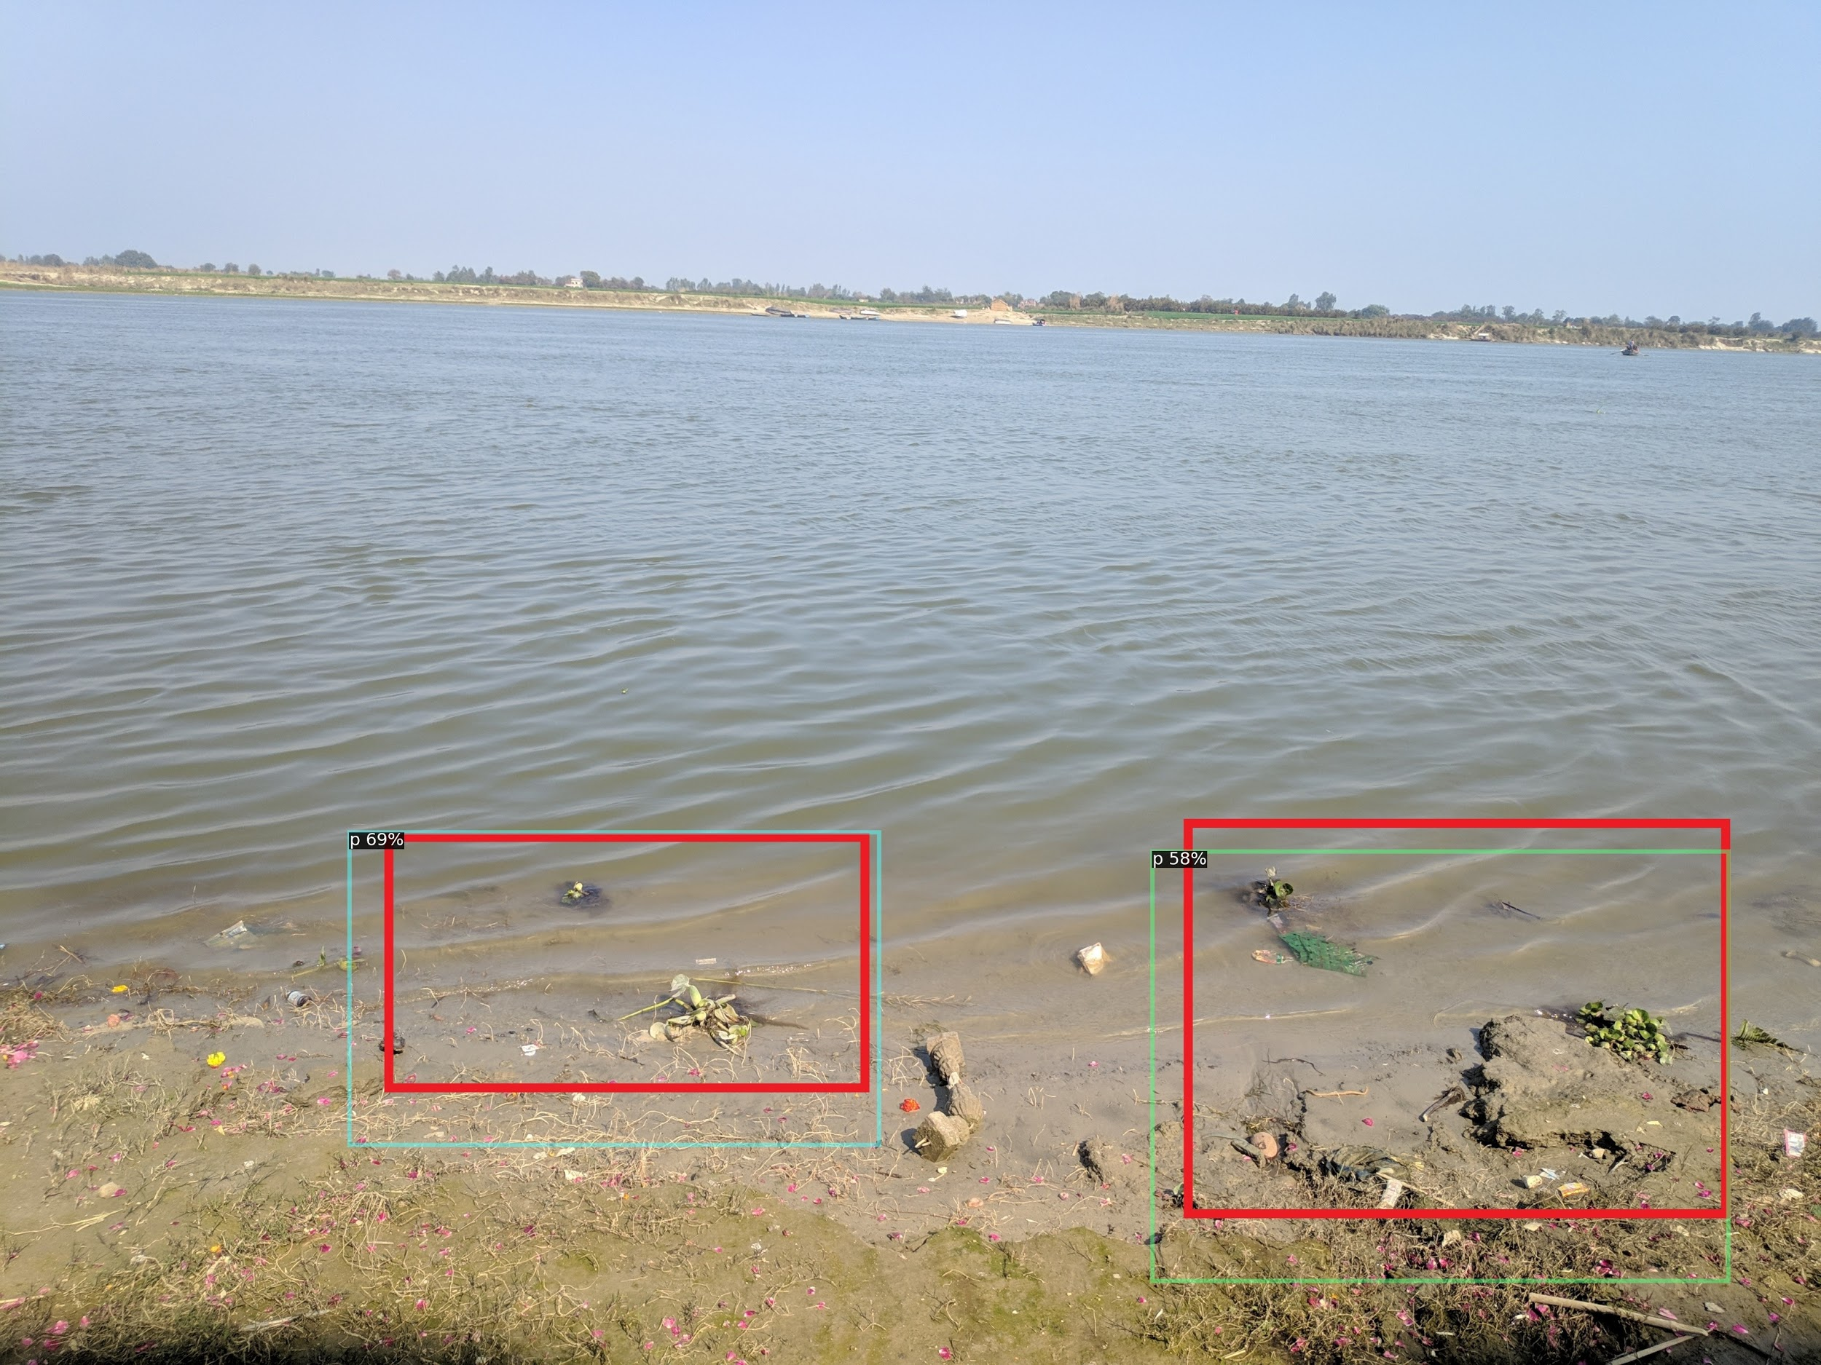

Slide 27
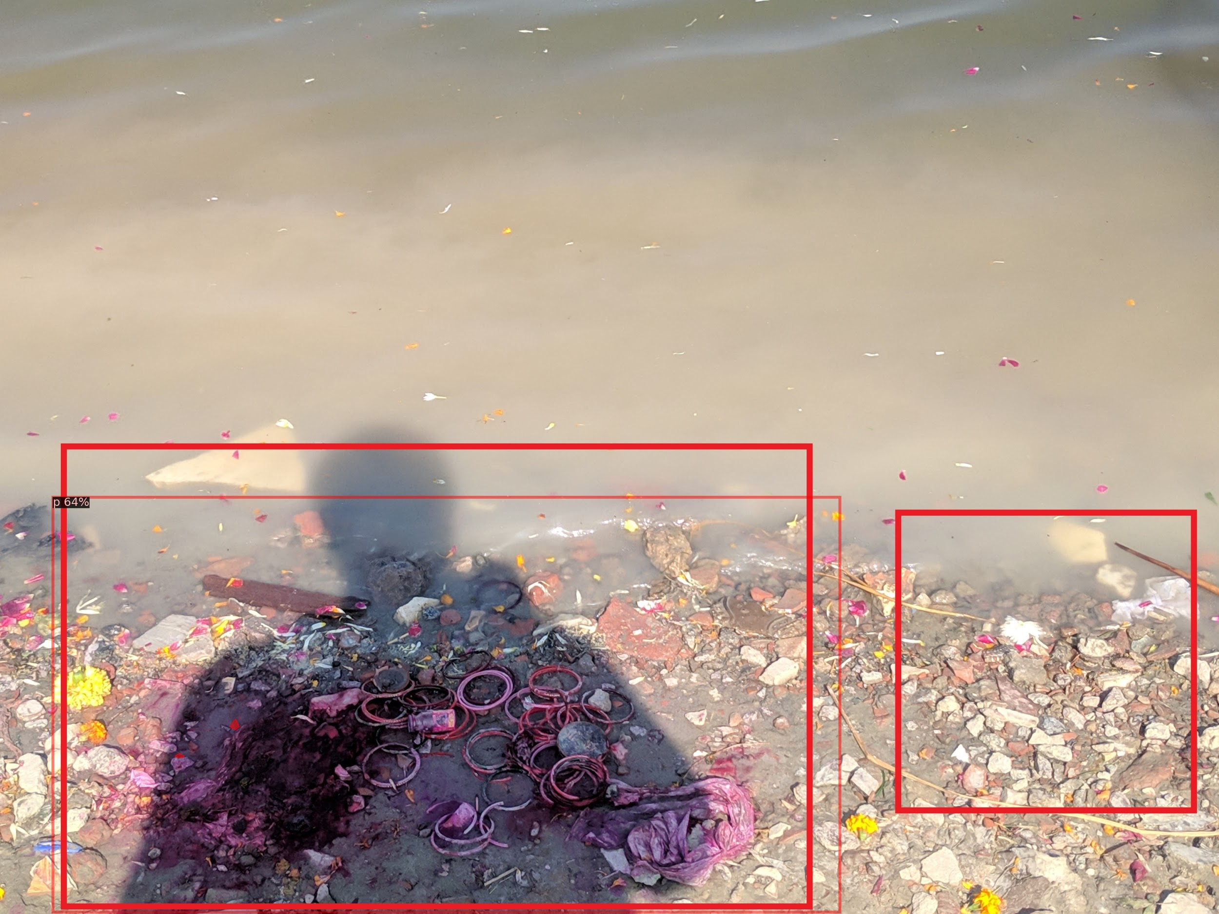

Slide 28
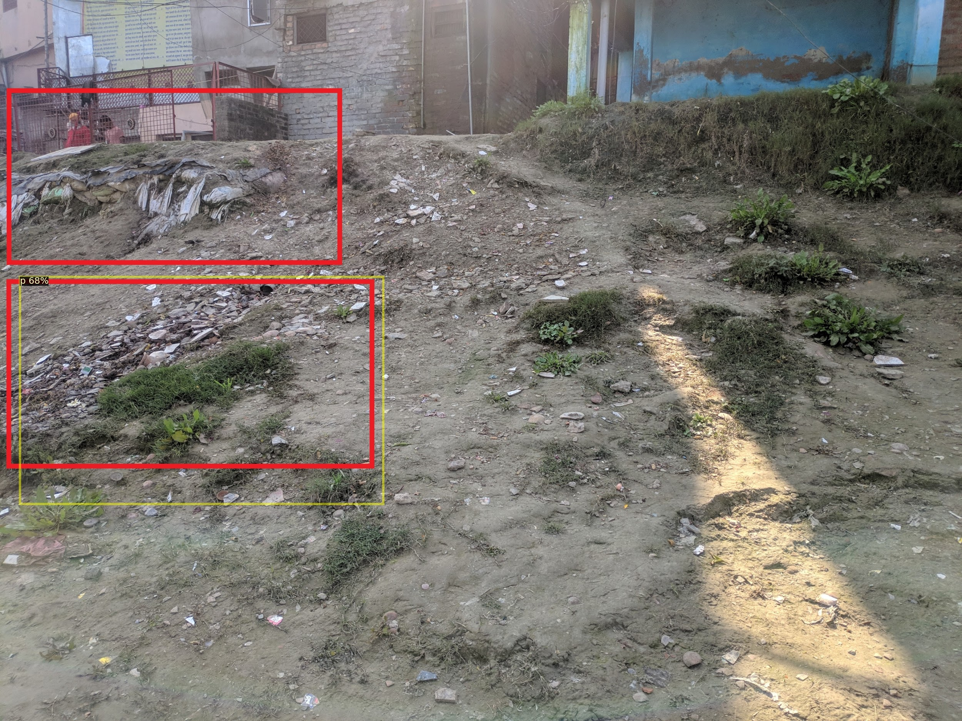

Slide 29
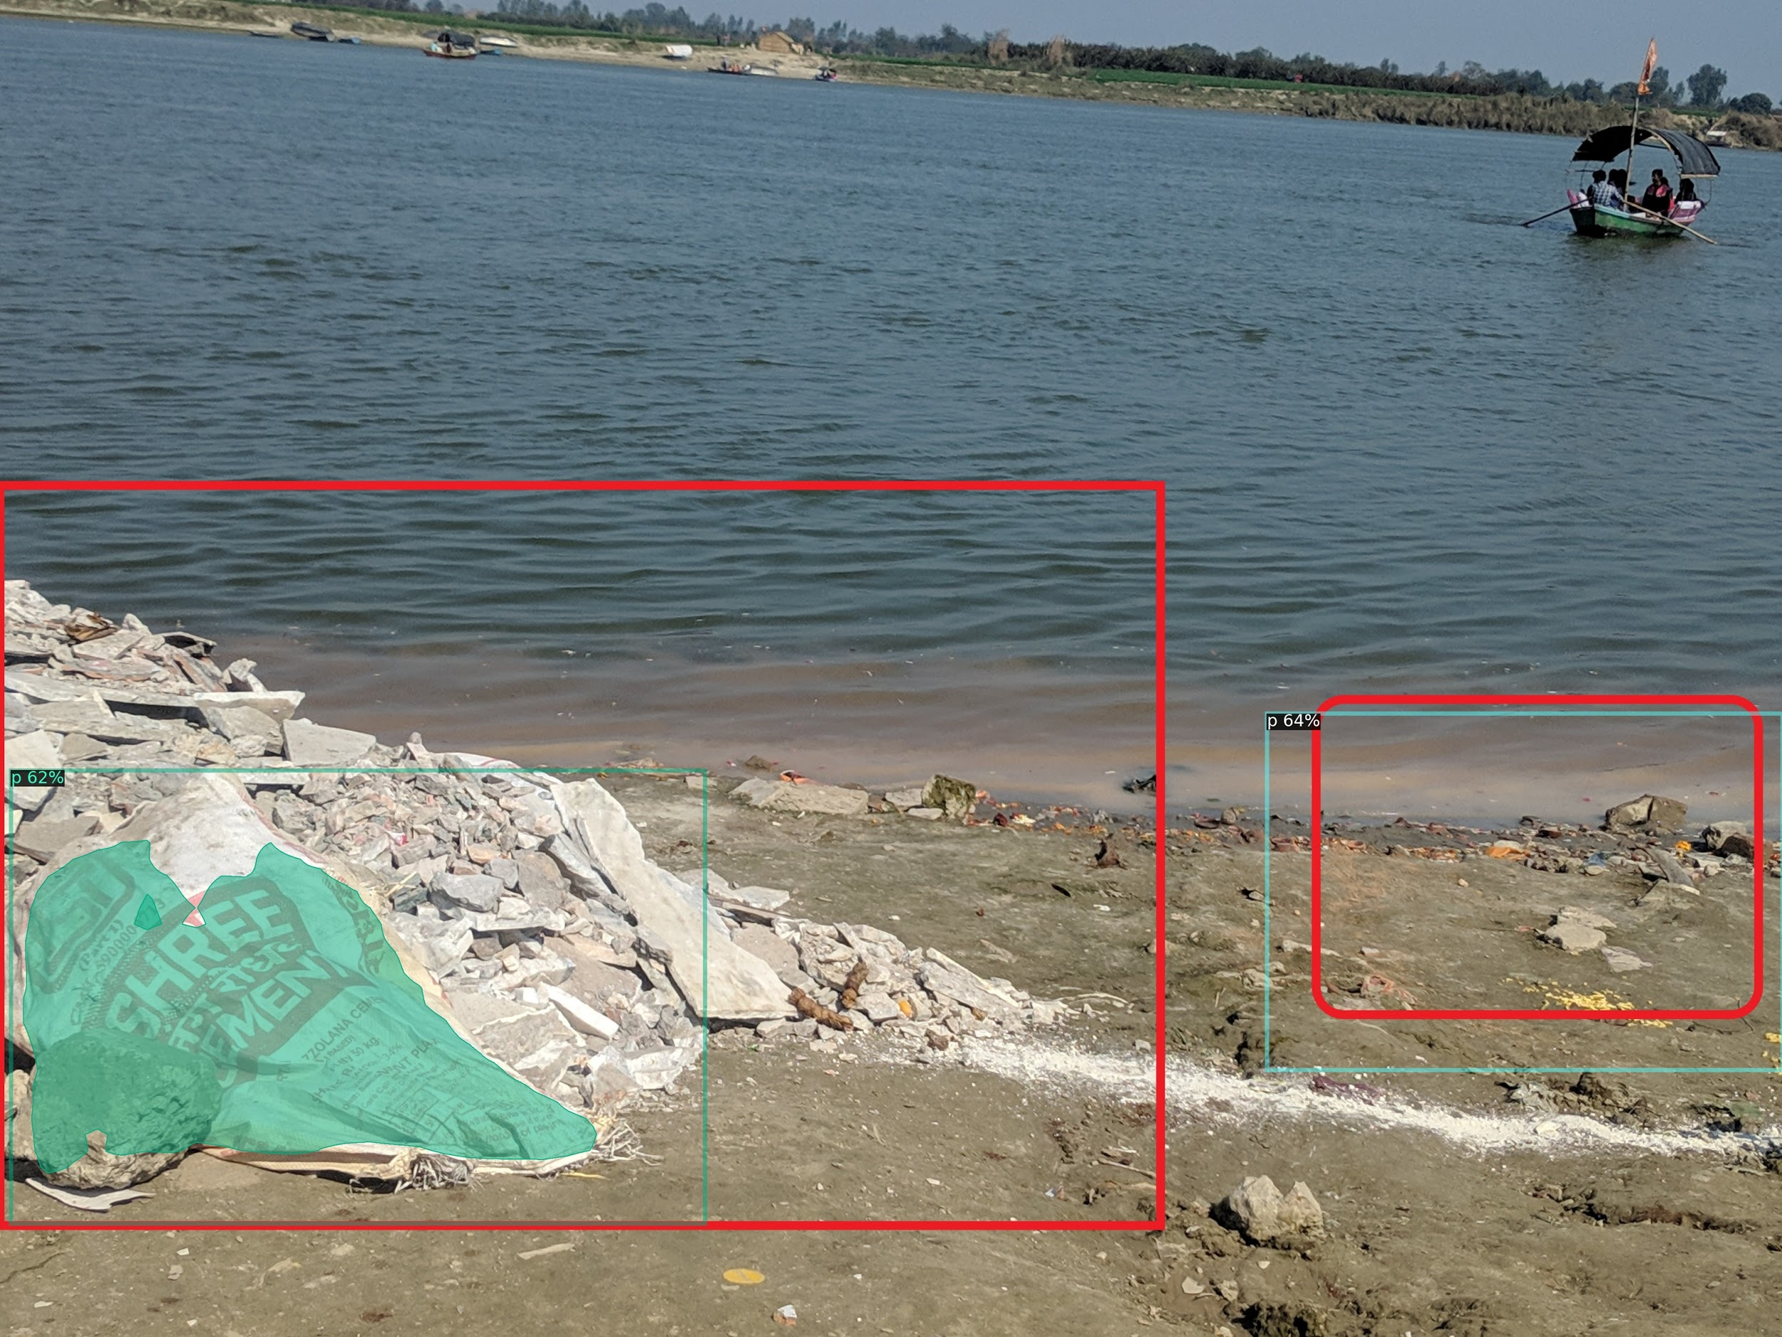

Slide 30
Results
 | TP | FP | FN
Count | 116 | 8 | 100
Threshold | 0.5
IOU | 1.03571428571429

Slide 31
Improvements that can be done
1- More data- by data augmentation
2- Better accuracy- by hyperparameter optimization

Slide 32
Thank you

